Slide 1
Introduction to GitHub Actions
Richard Fennell CTO Black Marble, Microsoft MVP

Slide 3
How do I write my own Custom Action?
How did we do CI/CD for GitHub?
What are GitHub Actions?

Slide 4





How did we do CI/CD for GitHub?
Notes:
We used an external system

Slide 5
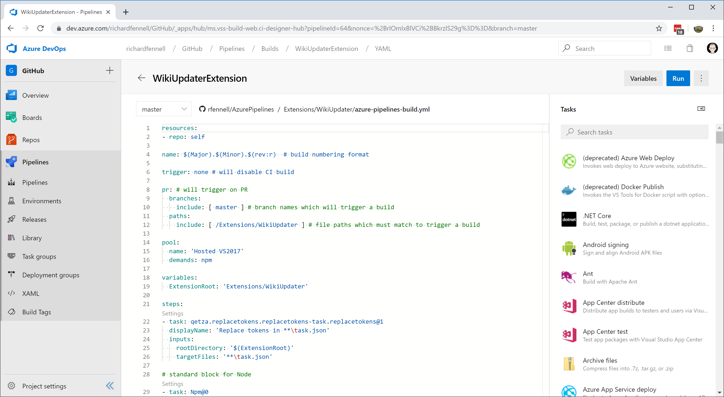

Slide 6
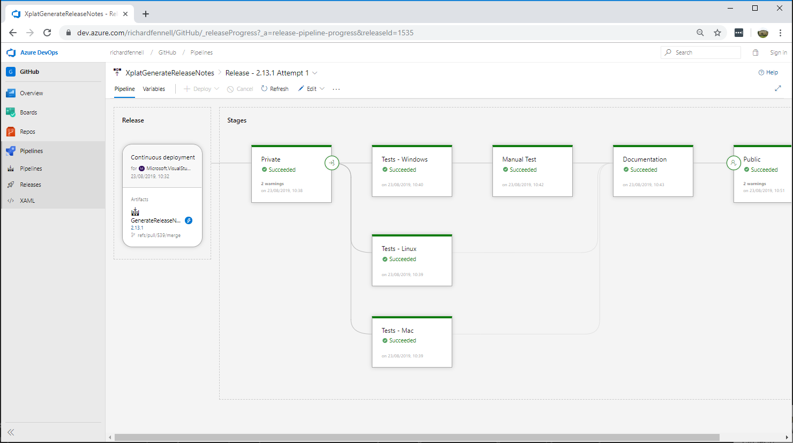

Slide 7
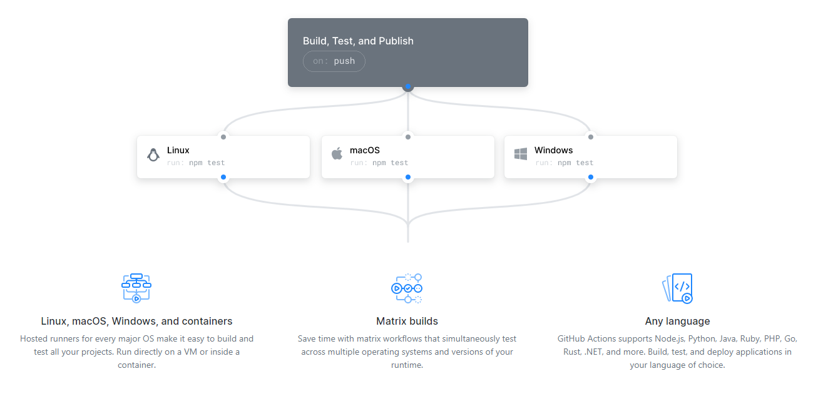
What are GitHub Actions?
Notes:
A means to do CI/CD inside the GitHub experience.
For those familiar with Azure DevOps pipeline you will see known concepts, but this is all new language and action wise
Linux, macOS, Windows, and containers
Matrix builds
Any language

Slide 8
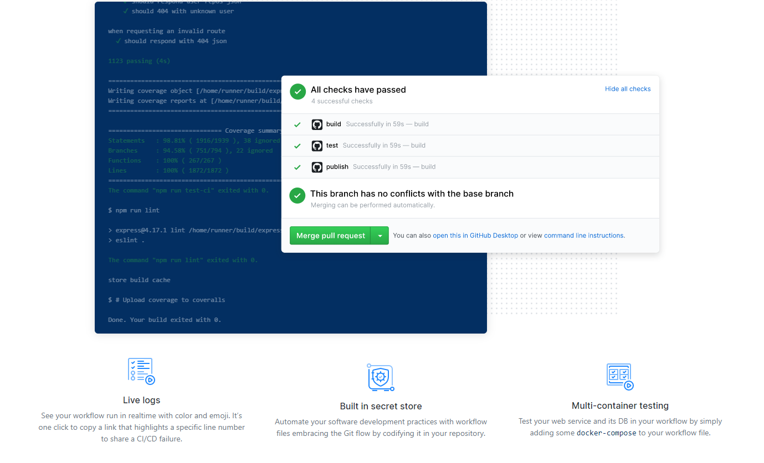
What are GitHub Actions?
Notes:
Live Logs
Built in secret store
Multi-container testing

Slide 9
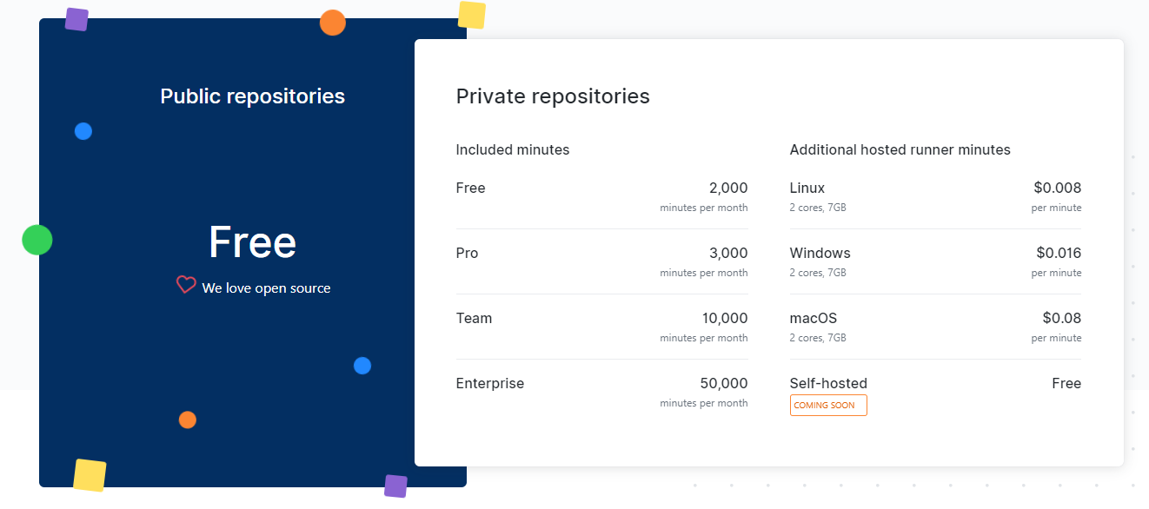
Simple, pay-as-you-go pricing

Slide 10
Demo: Your first Workflow
Notes:
Add a workflow to a hello world node app
When triggered

Slide 11
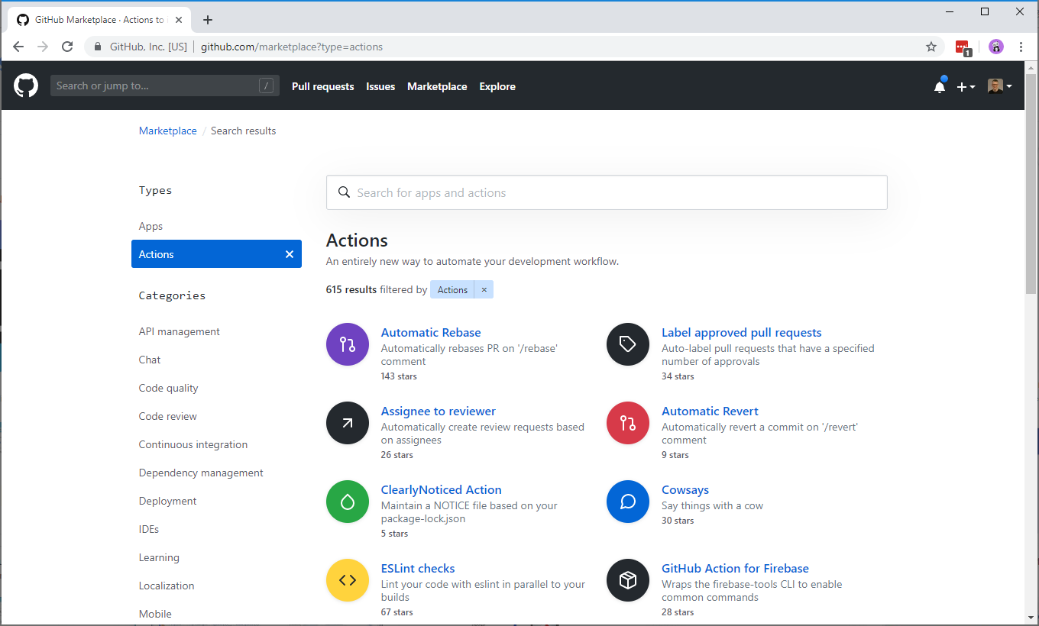
Community-powered workflows

Slide 12
But I have some custom Azure DevOps Pipeline Tasks. Can I reuse them?

Slide 13
What is a good candidate?
Should be written in Node.JS
Can’t make use of Azure DevOps specific APIs
Must do something that is useful in GitHub workflows
Notes:
Of course you can port other languages
Docker opens up interesting opportunities

Slide 14
How did I write my own Custom Action?
Create a new repo from the template generator
https://github.com/actions/typescript-action
Copied in my task code into the repo bit by bit
Removed any Azure DevOps specific code that was not needed
Swapped the references to “vsts-task-lib/task” to “@actions/core”
Swapped tests from Mocha/Chai to Jest
Add running of TSLint to the build process
Updated the action manifest to expose parameters
Notes:
Create a new repo from https://github.com/actions/typescript-action
Copied in my task code into the repo bit by bit
Renamed my entry ApplyVersionToJSONFile.ts file to main.ts to keep inline with the template standard
Copied over the AppyVersionToJSONFuncitons.js
I removed any Azure DevOps specific code that was not needed.
In both files swapped the references to “vsts-task-lib/task” to “@actions/core” and update the related function calls to use
core.getInput()
core.debug()
core.warning()
core.SetFailed()

Slide 15
Creating a Release Branch
# comment out in distribution branches
# node_modules/
$ git checkout -b releases/v1
$ git commit -a -m "prod dependencies"
$ npm prune --production
$ git add node_modules
$ git commit -a -m "prod dependencies"
$ git push origin releases/v1

Slide 16
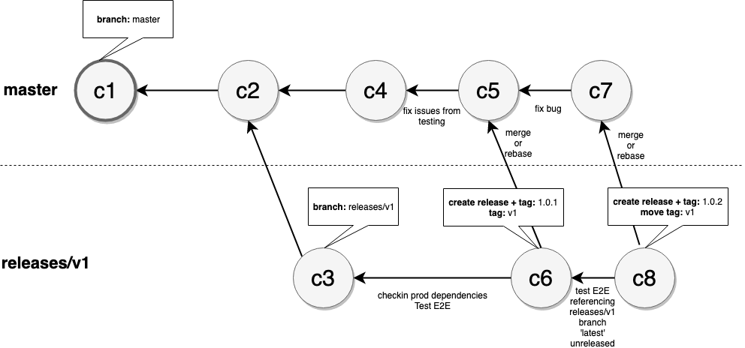
Versioning your updates
https://github.com/actions/toolkit/blob/master/docs/action-versioning.md

Slide 17
How to use your action in a workflow?
steps:
- uses: rfennell/JSONFileVersioner@74bc508 # a specific commit of a public action
- uses: rfennell/JSONFileVersioner@v1.0 # the major version of a release of a public action
- uses: rfennell/JSONFileVersioner@master # a branch of a public action - uses: ./ # Uses a private action in the root directory of workflow repo

Slide 18
Finally add it to the GitHub Marketplace
In your GitHub repo create a new draft release
Select ‘Publish to Marketplace’
Fix any errors, usually by checking in or editing files
Choose categories
Pick the tag that points to version to release
Click Publish release

Slide 19
Demo: A look at a Custom Action

Slide 20
Summary
GitHub Actions are a new alternative for CI/CD
You now don’t have to leave GitHub or provision other resources
They are free for OSS and pay-per-minute for private repo
They are not as rich in features as Azure DevOps, yet…
There is an active community
https://github.community/t5/GitHub-Actions/bd-p/actions
And documentation at
https://help.github.com/en/categories/automating-your-workflow-with-github-actions

